Slide 1
Perfect Squares & Square Roots
Integrated mathematics

Slide 2
Objective
Students will apply the concepts of square roots and perfect squares to simplify the values of square roots.

Slide 3
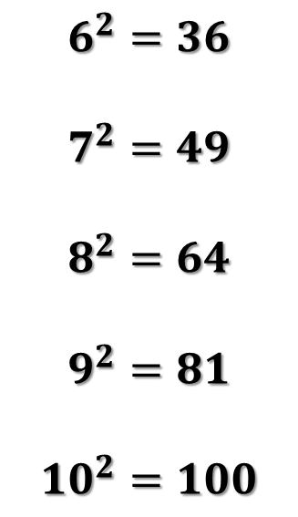
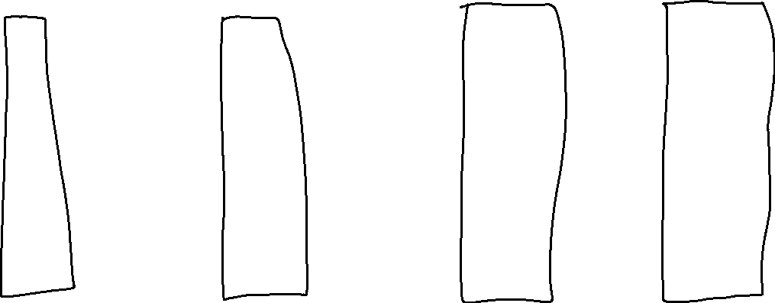
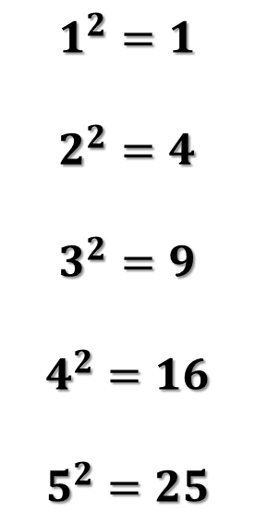
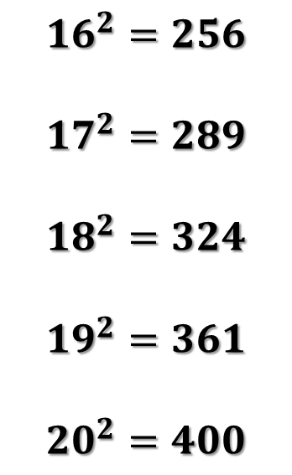
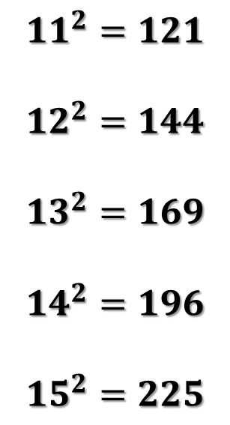
Perfect Squares
The Squares of Whole Numbers
  Whole Number Multiplied by Itself
$$1^{2}=1$$
$$2^{2}=4$$
$$3^{2}=9$$
$$4^{2}=16$$
$$5^{2}=25$$
$$6^{2}=36$$
$$7^{2}=49$$
$$8^{2}=64$$
$$9^{2}=81$$
$${10}^{2}=100$$
$${11}^{2}=121$$
$${12}^{2}=144$$
$${13}^{2}=169$$
$${14}^{2}=196$$
$${15}^{2}=225$$
$${16}^{2}=256$$
$${17}^{2}=289$$
$${18}^{2}=324$$
$${19}^{2}=361$$
$${20}^{2}=400$$
No Fractions or Decimals

Slide 4

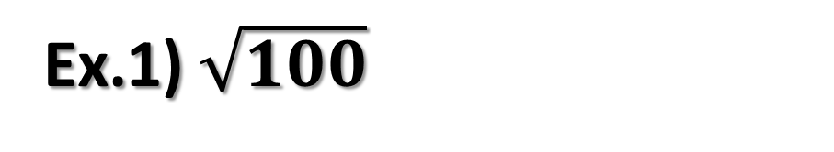
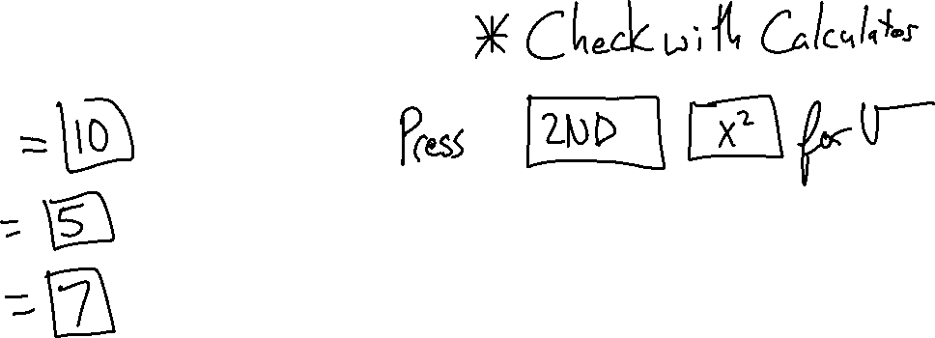
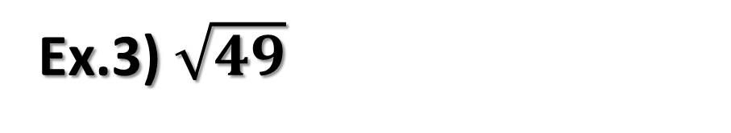
Square Roots
The square root of a number can be multiplied by itself, or squared, to equal the number
Examples
Ex.1) $\sqrt{100}$
Ex.2) $\sqrt{25}$
Ex.3) $\sqrt{49}$
Every positive number has 2 square roots that are opposite in sign

Slide 5
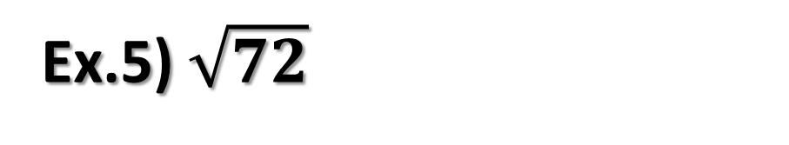
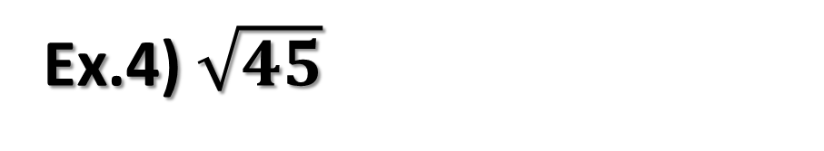
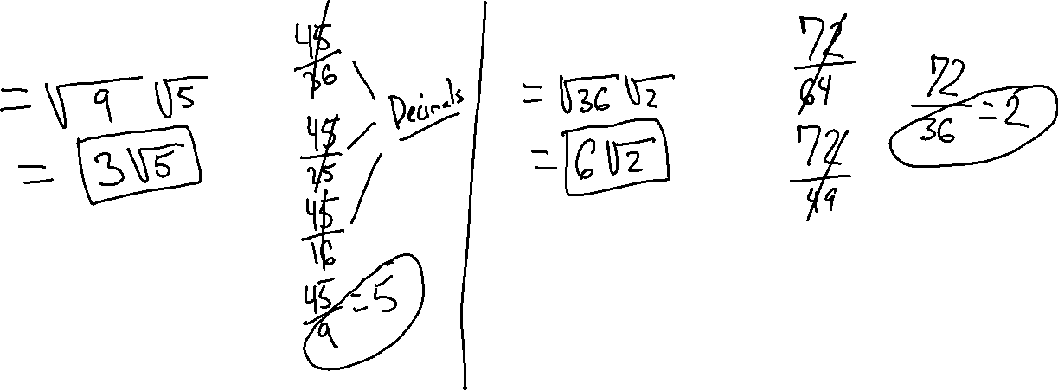
Simplify the Square Roots
Find a perfect square that multiplies with another whole number to equal the number under the radical
Ex.4) $\sqrt{45}$
Ex.5) $\sqrt{72}$

Slide 6
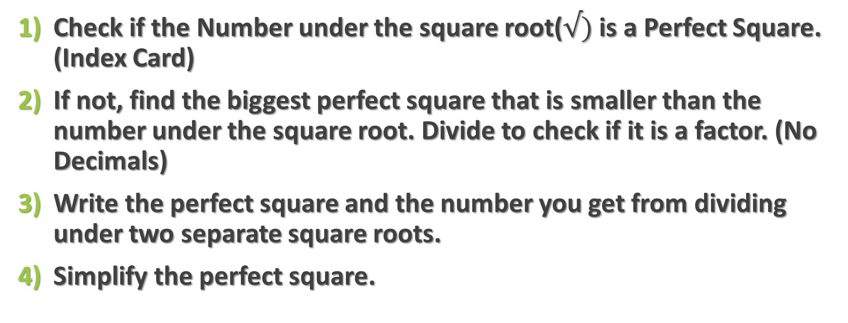
Review of Simplifying Square Roots
Check if the Number under the square root($√)$is a Perfect Square. (Index Card)
If not, find the biggest perfect square that is smaller than the number under the square root. Divide to check if it is a factor. (No Decimals)
Write the perfect square and the number you get from dividing under two separate square roots.
Simplify the perfect square.

Slide 7
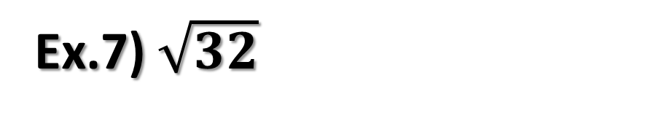
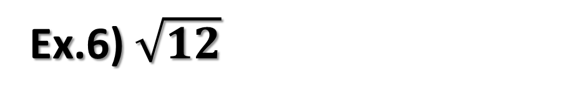
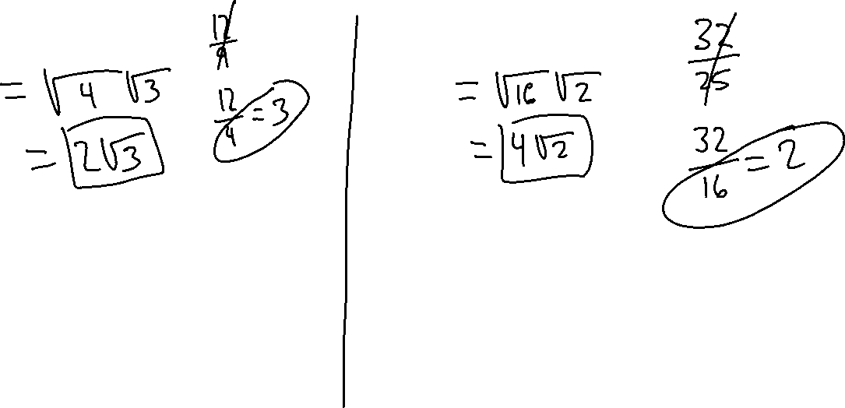
Simplify the Square Roots
Ex.6) $\sqrt{12}$
Ex.7) $\sqrt{32}$

Slide 8
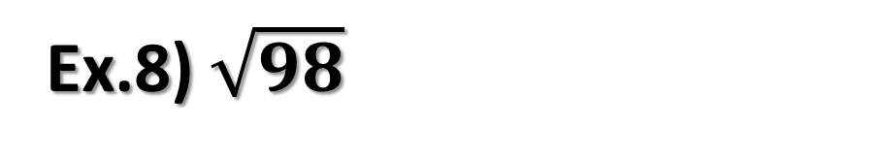
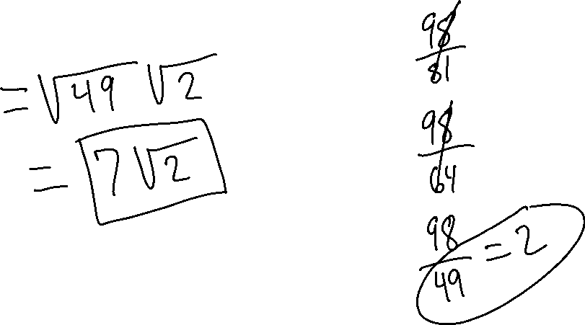
Simplify the Square Roots
Ex.8) $\sqrt{98}$

